Slide 1

Test of Significance
Presented by:
Elizer Ponio Jr.
Department of Computer Science
College of Computing and Information Technologies

Slide 2
Outline
Why do we need to do Test of Significance?
Parts of a Significance Tests
Stating Hypothesis
Define P-value
Conduct and interpret a significance test
Determine significance

Slide 3
Recap: Statistical Inference
Confidence intervals are one of the two most common types of statistical inference.
Researchers use a confidence interval when their goal is to estimate a population parameter.
The second common type of inference, called a test of significance, has a different goal: to assess the evidence provided by data about some claim concerning a population.

Slide 4
Recap: Statistical Inference
The second common type of inference, called a test of significance, has a different goal:
To assess the evidence provided by data about some claim concerning a population.

Slide 5
Test of Significance
A test of significance is a formal procedure for comparing observed data with a claim (also called a hypothesis), the truth of which is being assessed.
The first step in conducting a test of statistical significance is to state the hypothesis.

Slide 6
Hypothesis Testing
In hypothesis testing, a decision between two alternatives must be made.
One of which is called the null hypothesis and the other the alternative hypothesis

Slide 7

Null Hypothesis
The null hypothesis is a form of hypothesis that is deemed “true” until proven wrong based on experimental data.
It is defined as the commonly accepted fact (such as the sky is blue) and the researcher’s aim is to reject or nullify this fact.
The notation that is typically used for the null hypothesis is $H_{o}$

Slide 8
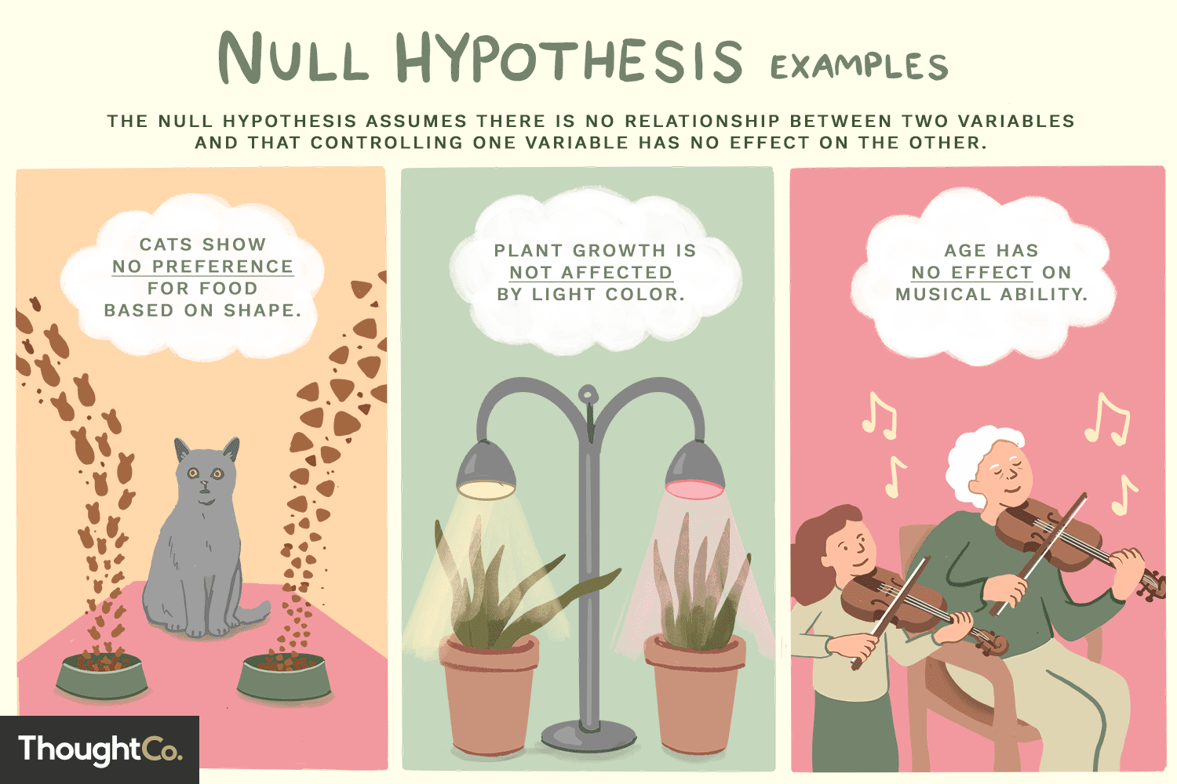

Slide 9
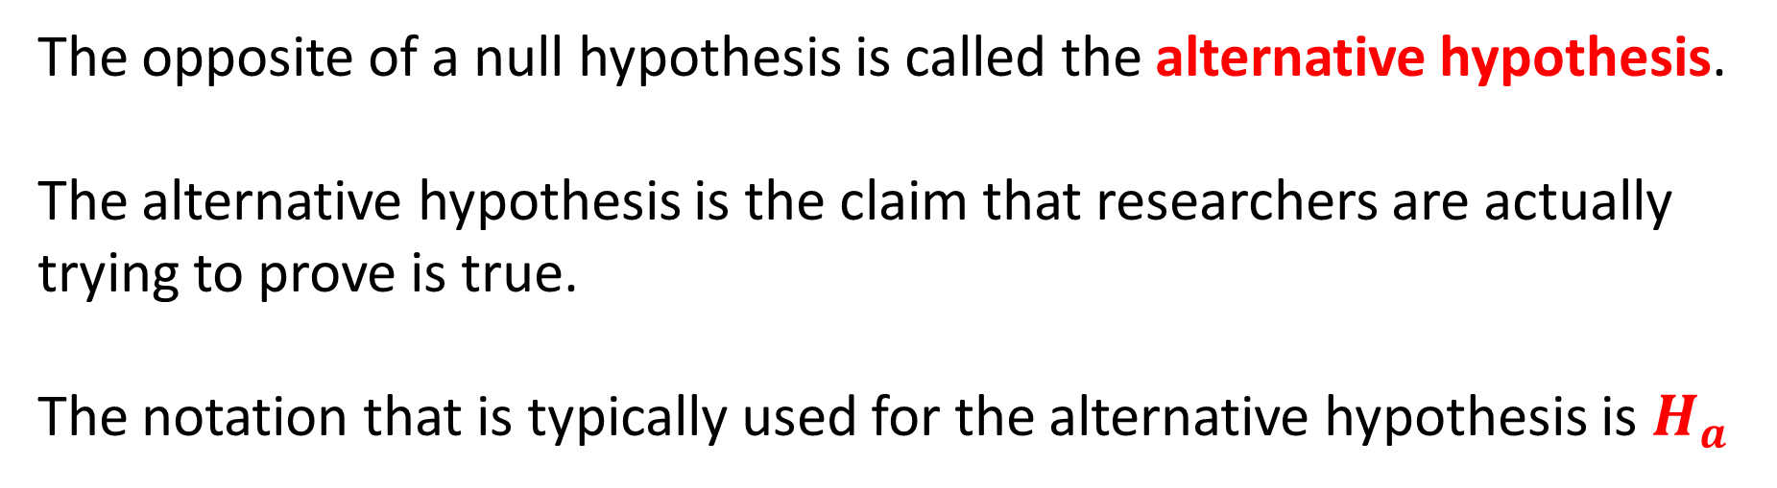
Alternative Hypothesis
The opposite of a null hypothesis is called the alternative hypothesis.
The alternative hypothesis is the claim that researchers are actually trying to prove is true.
The notation that is typically used for the alternative hypothesis is $H_{a}$

Slide 10
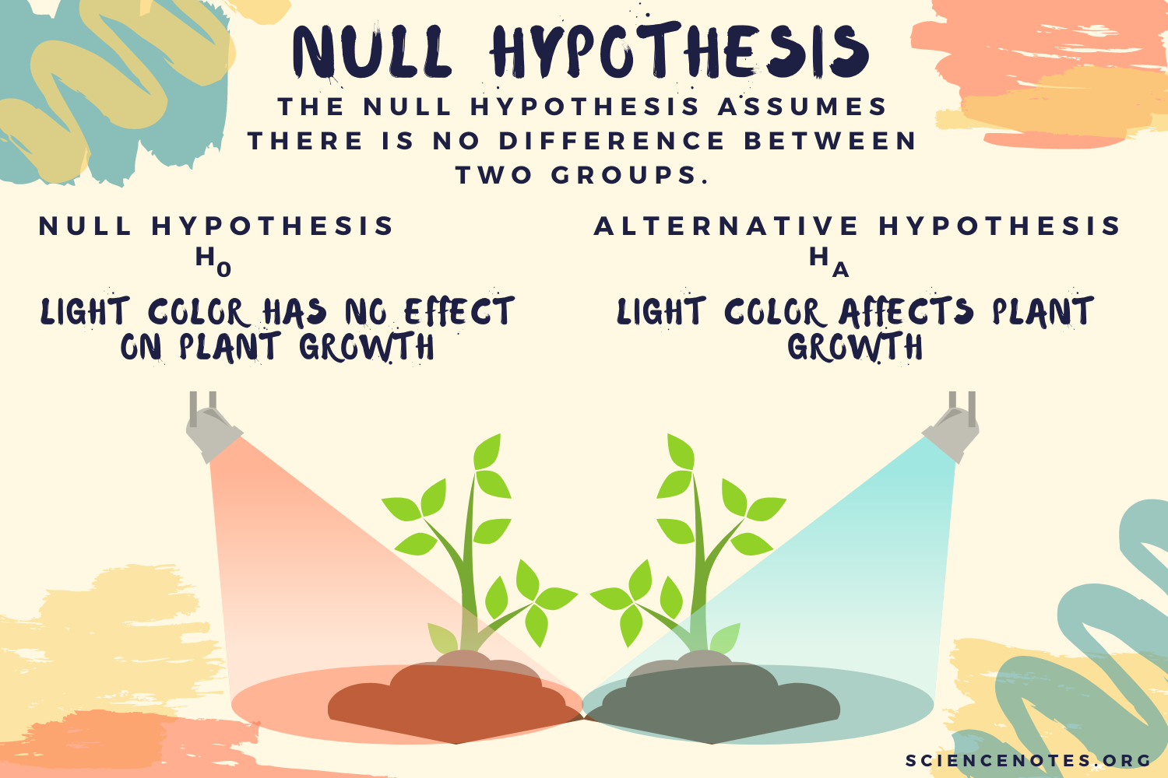

Slide 11

Court Trial Example
The process of testing hypotheses can be compared to court trials.
A person comes into court charged with a crime.

Slide 12
Court Trial Example
A jury must decide whether the person is not guilty (null hypothesis) or guilty (alternative hypothesis).

Slide 13
Court Trial Example
Even though the person is charged with the crime, at the beginning of the trial (and until the jury declares otherwise) the accused is assumed to be not guilty of the crime.
Only if overwhelming evidence of the person's guilt can be shown is the jury expected to declare the person guilty, otherwise the person is considered not guilty.

Slide 14
Test of Significance
When conducting a significance test, the goal is to provide evidence to reject the null hypothesis.
If the evidence is strong enough to reject the null hypothesis, then the alternative hypothesis can automatically be accepted.
However, if the evidence is not strong enough, researchers fail to reject the null hypothesis.

Slide 15
Example Problem
In the philipines, the mean height of male is 5’7’’ with a standard deviation of 3.5″. What is the probability of finding a random sample of 50 males with a mean height of 7’0”, assuming the heights are normally distributed?

Slide 16

Example Problem
In the philippines, the average or mean height of males is 5’3’’ or 63.6 inches with a standard deviation of 3.5″.
What is the probability of finding a random sample of 16 males with a mean height of 7’0” or 84 inches, assuming the heights are normally distributed?

Slide 17

Step 1: Get the Z-Score
$$z= \frac{\overline{x} − μ}{\frac{σ}{\sqrt{n}}}$$
Where:
$\overline{x}$ is the Population mean height
$σ$is the Population standard deviation
$μ$is the sample mean
$n is the s$ample size

Slide 18

Step 1: Get the Z-Score
$\overline{x}$= 84 inches
$σ$= 3.5
$μ$= 36.6 inches
$n$= 16
$$z= \frac{84−63.6}{\frac{3.5}{\sqrt{16}}}$$
$$z= \frac{20.4}{0.875}$$
$$z=23.314$$

Slide 19

Step 2: Get the p-value
$$z=23.314$$

